Slide 1
EDB side event in Bangkok
October 13-14th, 2026
ver 001

Slide 2
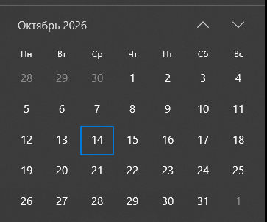
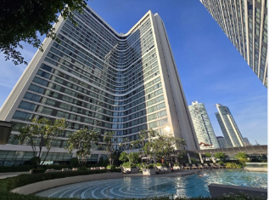
General information
Date: October 13-14, 2025
Location: Marriott Marquis Queen’s Park, Bangkok, Thailand
Number of participants: 80-100 participants (including participants from the EDB)
Aims and objectives of the event:
To present the EDB's work and cooperation formats;
To outline common interests and agree on next steps with stakeholders.
Preliminary program (TBD):
October 13
09:00-15:00 – Installation and set up;
15:00-16:00 – Technical check
15:00-18:00 – Rehearsal with all teams and personnel;
October 14
09:00-15:00 – Technical check;
15:00-18:00 – Rehearsal with all teams and personnel;
19:00-20:00 – Registration, welcome drink;
20:00-20:15 – Presentations about the EDB;
20:15-23:00 – Cocktail and networking;
Client responsibilities: venue hall rental and catering at the hotel
Agency responsibilities: all items listed in the presentation, except venue hall rental and catering at the hotel
Furniture: Agency to confirm furniture availability with the hotel; if unavailable, arrange rental

Slide 3
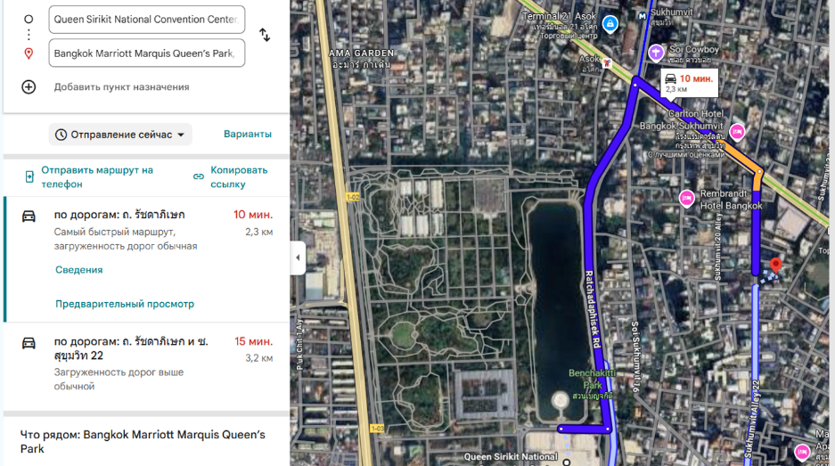
Route

Slide 4
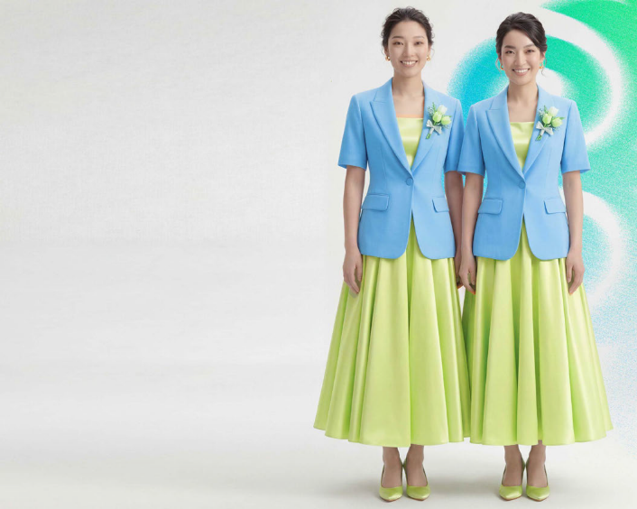
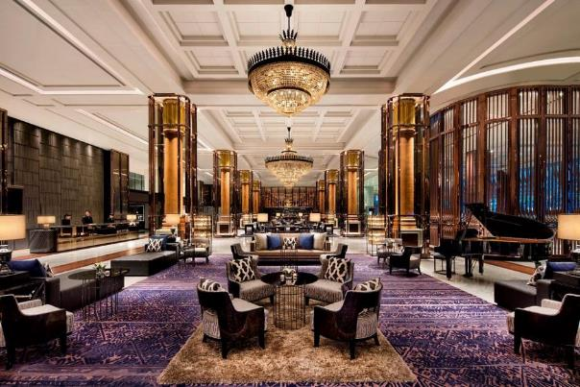

Lobby
2 hosts in the lobby with signs greet guests and escort them to the elevator area, directing them to the correct floor

Slide 5
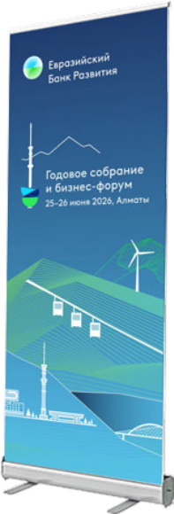
Elevators areа
A roll-up banner with event details is placed in the elevator area, entrance, parking (3 pieces total)

Slide 6
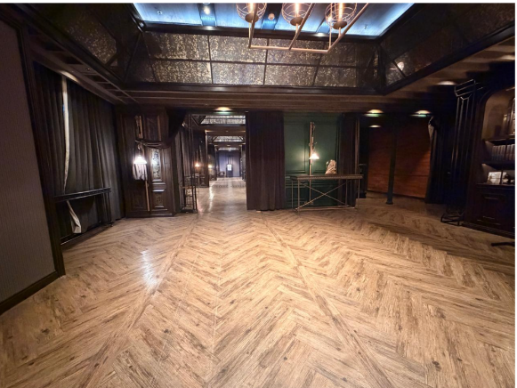
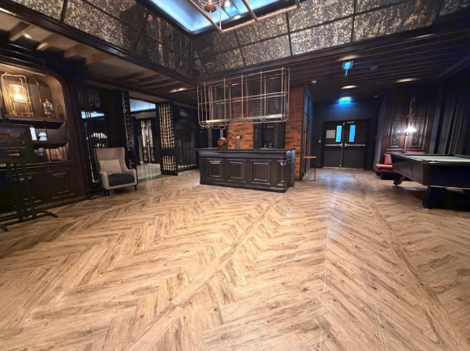
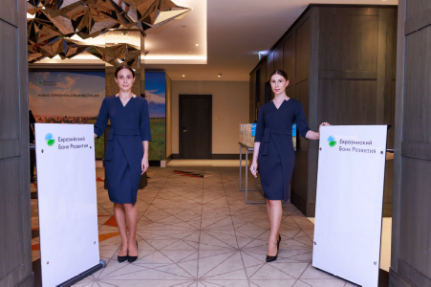
Entrance area
Elevators
On the 27th floor foyer: 2 hosts at reception desks greet guests, check them in, and hand out wristbands.
A table with welcome bags and souvenirs is nearby: 2 additional hosts hand out bags to registered guests.
2 security guards in black suits monitor the entrance corridor.

Slide 7
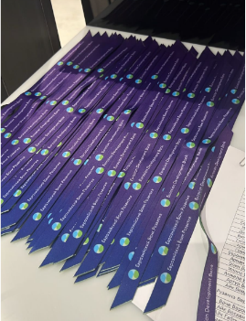
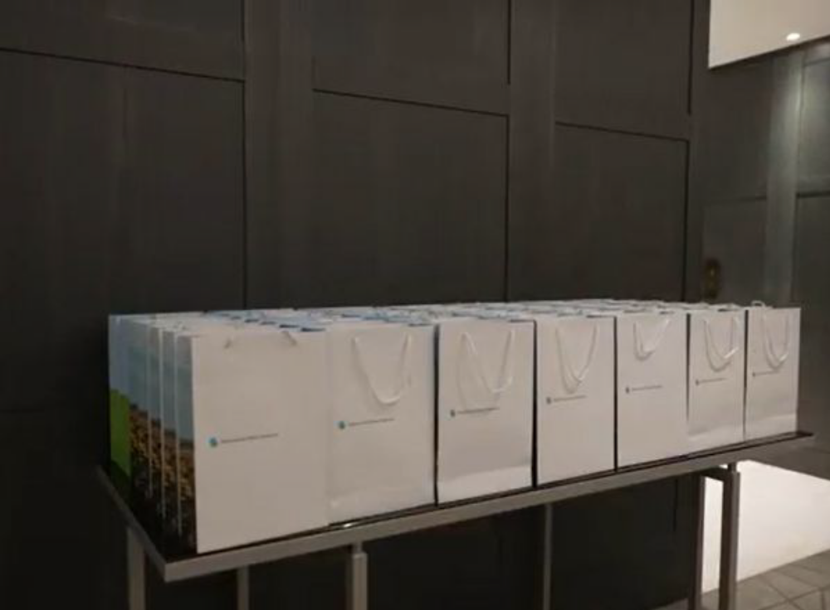
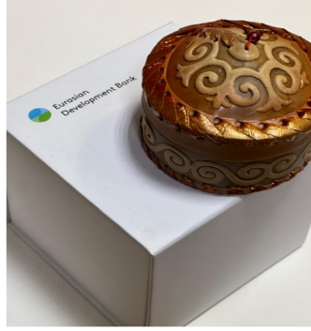
Participant Welcome Pack
Wristband – 120 pcs.
Branded bag – 100 pcs.
Souvenir – 100 pcs.
Please suggest an alternative to a yurt-themed souvenir.
Souvenir should reflect the Eurasian region theme.
If the souvenir itself cannot be branded, it must come in a box with the logo.
Total cost: up to $10 per item.

Slide 8
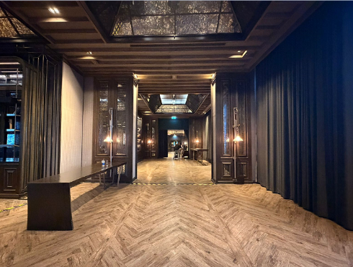

Pre-function area
After registration, guests proceed through a corridor leading to the hall, where pre-event activities take place.
Food and drink stations (podiums) featuring offerings from each country, with decor and signage aligned with the concept.
A banner (5W x 3H m) with 3D elements along the wall, and a decorative sculptural element next to it.
Dim ambient lighting with accent spotlights on key elements and the photo zone.
Ethnic-style music.

Slide 9
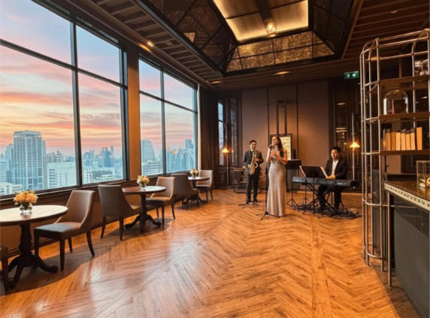
Band
Place small tables along the windows.
Arrange a live music band opposite the corridor: an attractive female vocalist with several musicians.
Develop a setlist of vibrant, recognizable songs representing 7 member countries of the Bank.
During each song, matching visual content should be displayed on the screen.

Slide 10

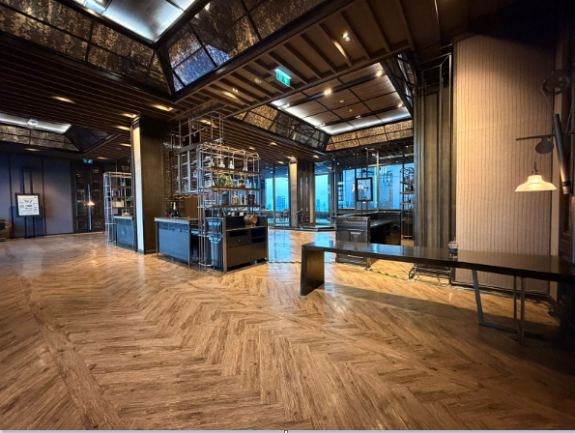
Main area, entrance
In the main hall entrance area:
The table may be used for a welcome drink station, or repurposed differently — please suggest alternatives.
Provide small 2-3 person tables with armchairs along the windows, plus cocktail tables.

Slide 11
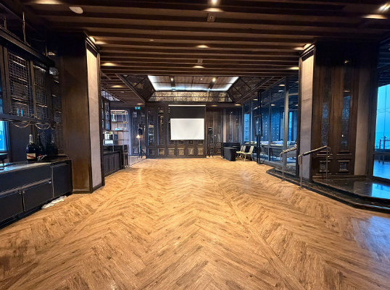
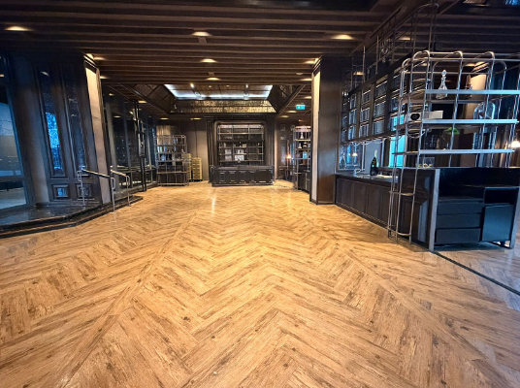
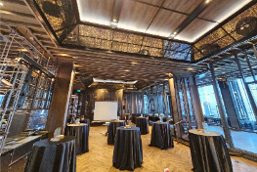
Main hall
LED Screen
4m*5m
Main hall setup includes:
LED screen ((pixel pitch max 2mm), 4W x 5H m (floor-to-ceiling).
Lectern, speaker microphone (gooseneck + 2 wireless mics).
Cocktail tables. Each table to have an illuminated branded element (totem) – 20 pcs.
Floral arrangements as needed.
Soft ambient floor lighting.

Slide 12
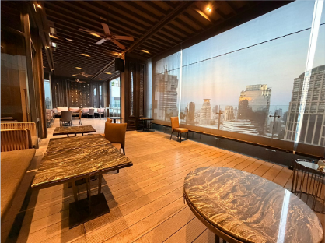
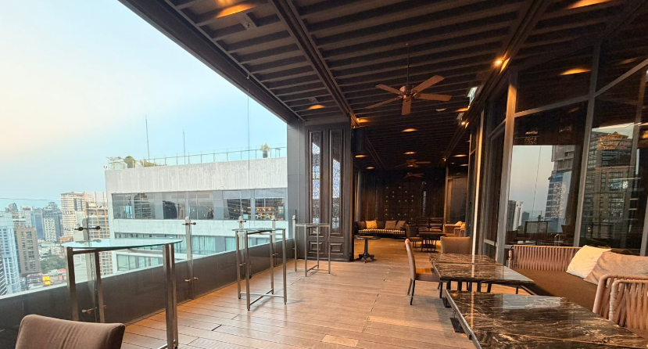
Terrace
Provide audio feed from the main hall on the terrace.
TV screen 75–80 inches.
Ambient fill lighting.
Floral arrangements.

Slide 13
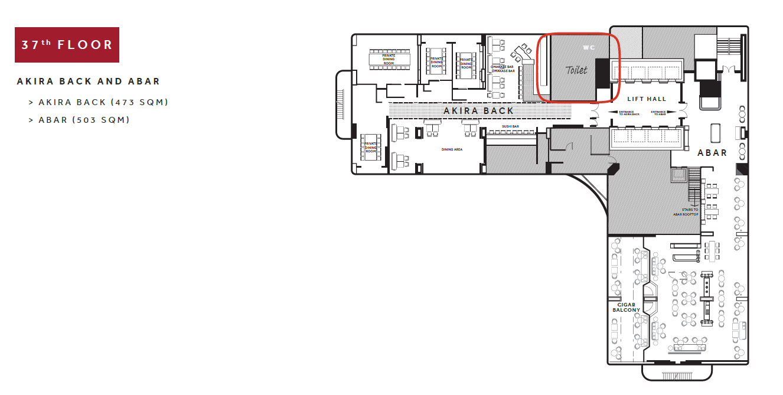
Meeting room rent in the hotel
AKIRA restaurant Private dining room must be rented for 2 days (1 pm-11 pm) to be used as a meeting room for EDB staff.

Slide 14
PR activities
Organizing an announcement campaign:
social media (LinkedIn mainly), narrow geo-targeted advertising (Google mainly),
BTL activities (e.g., placement of roll-up stands at hotels where delegations are staying) – in minimum two 5star hotels. Includes production of BTL structures and other materials. Includes agreements with the hotels.
The contractor is responsible for compliance with local legislation in this regard.
The contractor is responsible for collecting complete detailed statistics on advertising campaign effectiveness.
. Ensuring media (press) operations at the event:
- Inviting and accrediting media (calls, correspondence, list management);
- Meeting media at the entrance, issuing badges, monitoring attendance;
- Ensuring participation of no fewer than 10 media outlets (no more than 5 from Thailand, the rest must be international media or media from China and the Middle East)
- Navigation and coordination of media across the venue (including press approaches, if needed)
- Organizing transfer for media from the venue of the World Bank Annual/Fall Meetings to the event and from the event to hotels (for non-local media)
Ensuring photo and video coverage:
Production of mobile-shot video clips the day after the event.
Photos are delivered to the client on the day of the event; edited/processed photos are sent the following day.
Creating an event landing page with 2 registration forms: for media and for participants — in English.
Developing and producing welcome souvenir items for media featuring the EDB 20th anniversary branding (useful souvenirs), costing no more than $50 per set – 15 welcome packs

Slide 15
Personnel
Project Manager
Producer
Venue Manager
Logistics & Production Manager
Technical Director
Photographer – 2
Mobile content creator – 1
Videographer - 1
Hostess – 4
Helpers – 2
MC / Compere (English-speaking) – 1
DJ -1
All staff dressed in black.
Hostess/HostHostesses in black sheath dresses + accent in brand colours.
MC in a tuxedo.

Slide 16
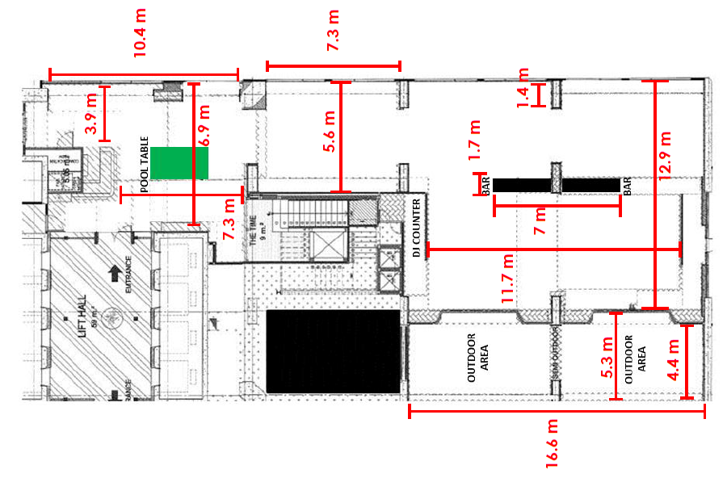
Dimensions

Slide 17
Additional Information
We are glad to invite you to debriefing meeting that will be held August 5, at 11 am (Moscow time)
In order to participate in the meeting, please send you request for zoom link on the email: krutskikh_ma@ eabr.org
The following link contains guidelines and logotypes of the EDB https://eabr.org/edb-brandbook/

